Slide 1
Colossians big picture context
False teaching threatening the church
Christ is a good start but……
Paul’s answer
Christ is Supreme
Therefore Christ is Sufficient
Paul’s goal for them:-
V6/7 – “just as you have received Christ as Lord, continue to live in Him…strengthened in the faith…overflowing with thankfulness”

Slide 2
Col 2:20-23 Problem at root of error
Problem statement:-
How do we tame the lower appetites?
What steps can we take to put to death the “old man”?
False teachers thought all matter is evil
Led them to promote in asceticism
Links to v16/17 – diets
Links to mysticism v18/19 – eastern religions
Look out for - false humility, harsh treatment of the body

Slide 3
Colossians 2v20-23 – Don’t beat yourself up
²⁰ Since you died with Christ to the elemental spiritual forces of this world, why, as though you still belonged to the world, do you submit to its rules:
²¹ ‘Do not handle! Do not taste! Do not touch!’? ²² These rules, which have to do with things that are all destined to perish with use, are based on merely human commands and teachings.
²³ Such regulations indeed have an appearance of wisdom, with their self-imposed worship, their false humility and their harsh treatment of the body, but they lack any value in restraining sensual indulgence.

Slide 4
Col 2v20-23 – be master of your body
Everyone who competes in the games goes into strict training. 1 Cor 9v25

Slide 5
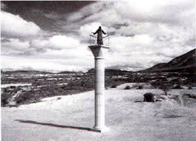
Colossians 2v20-23 – Don’t beat yourself up

Slide 6
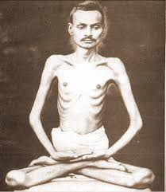
Colossians 2v20-23 – Don’t beat yourself up

Slide 7
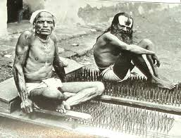
Colossians 2v20-23 – Don’t beat yourself up

Slide 8
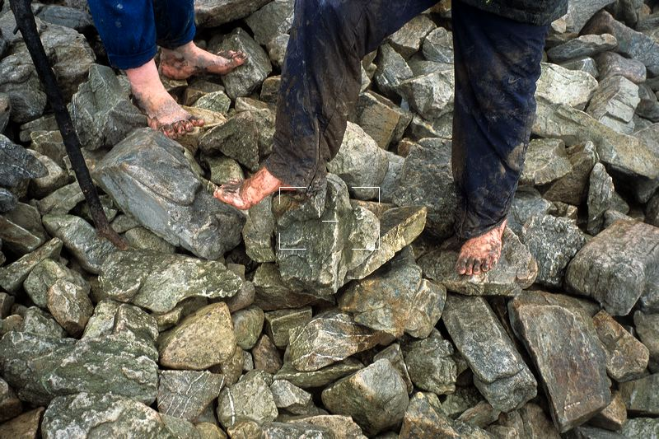
Colossians 2v20-23 – Don’t beat yourself up

Slide 9
Colossians 2v20-23 – Don’t beat yourself up
²⁰ Since you died with Christ to the elemental spiritual forces of this world, why, as though you still belonged to the world, do you submit to its rules:
Different kingdom, different rules
Governments?
Romans 13 – “Everyone must submit himself to the governing authorities”
Christ’s rules (Matt 22)
Love the Lord your God with all your heart and with all your soul and with all your mind
Love your neighbour as yourself

Slide 10
Colossians 2v20-23 – Don’t beat yourself up
²¹ ‘Do not handle! Do not taste! Do not touch!’? ²² These rules, which have to do with things that are all destined to perish with use, are based on merely human commands and teachings.
Different kingdom, different rules
Externals are not eternal
Religions and prohibitions
Christ and food laws (Mark 7v18-19)
‘Don’t you see that nothing that enters a person from the outside can defile them? ¹⁹ For it doesn’t go into their heart but into their stomach, and then out of the body.’ (In saying this, Jesus declared all foods clean.)

Slide 11
Colossians 2v20-23 – Don’t beat yourself up
²³ Such regulations indeed have an appearance of wisdom, with their self-imposed worship, their false humility and their harsh treatment of the body, but they lack any value in restraining sensual indulgence.
Different kingdom, different rules
Externals are not eternal
Deception of ascetism
Appearance of wisdom – trap
Appearance of humility – trap
Effectiveness in restraining sin – no value

Slide 12
Colossians 2v20-23 – Don’t beat yourself up
Different kingdom, different rules
Externals are not eternal
Deception of ascetism
The wonder of grace
There is nothing I can do to make God love me more
There is nothing I can do to make Him love me less

Slide 13
Colossians 2v20-23 – Don’t beat yourself up
Different kingdom, different rules
Externals are not eternal
Deception of ascetism
The wonder of grace
There is nothing I can do to make God love me more
There is nothing I can do to make Him love me less
The Problem with grace
“Every crook will argue: ‘I like committing crimes. God likes forgiving them. Really the world is admirably arranged’” W H Auden

Slide 14
Colossians 2v20-23 – Don’t beat yourself up
Different kingdom, different rules
Externals are not eternal
Deception of ascetism
The problem with grace
There is nothing I can do to make God love me more
There is nothing I can do to make Him love me less
“Every crook will argue: ‘I like committing crimes. God likes forgiving them. Really the world is admirably arranged’” W H Auden
What shall we say, then? Shall we go on sinning, so that grace may increase? ² By no means! We are those who have died to sin; how can we live in it any longer?
Rom 6v1-2

Slide 15
Colossians 2v20-23 – Don’t beat yourself up
Different kingdom, different rules
Externals are not eternal
Deception of ascetism
The problem with grace
Inside out, not outside in
Mark 7v20-23 ‘What comes out of a person is what defiles them. ²¹ For it is from within, out of a person’s heart, that evil thoughts come – sexual immorality, theft, murder, ²² adultery, greed, malice, deceit, lewdness, envy, slander, arrogance and folly.

Slide 16
Colossians 2v20-23 – Don’t beat yourself up
Different kingdom, different rules
Externals are not eternal
Deception of ascetism
The problem with grace
Inside out, not outside in
Mark 7v20-23 ‘What comes out of a person is what defiles them.’
Buried with Christ in baptism and now alive with Christ Colossian 2v12-13

Slide 17
Colossians 2v20-23 – Don’t beat yourself up
Different kingdom, different rules
Externals are not eternal
Deception of ascetism
The problem with grace
Inside out, not outside in
Mark 7v20-23 ‘What comes out of a person is what defiles them.’
Buried with Christ in baptism and now alive with Christ Colossian 2v12-13
Not externals and not effort but love
“If you but love God you may do as you incline”
St. Augustine of Hippo

